Slide 1
Team 5 – Rotor Blade Structures
Week No - 7
Date - 11.11.2025
Supervisor - Dr. Laurence Alhrshy
Presented by – Anudeep Allanki (770625)
Team Members - Bhima B Masare, Anudeep Allanki, Dongsuk Kim, Mithun Shetty

Slide 2
Contents
1. Rotor Blade Structures Team Time line
2. Tasks planned for Project
3. Spar Cap -
  3.1 About Spar Caps
      3.1.1 Types of Spar Caps
      3.1.2 Types of Bending Moments on Spar Caps
      3.1.3 Bending Stiffness of Spar Caps
      3.1.4 Bending Stress Analysis on Spar Caps
      3.1.5 Data required to fix the Spar Caps & Webs Geometry
Bibliography
Anudeep Allanki

Slide 3
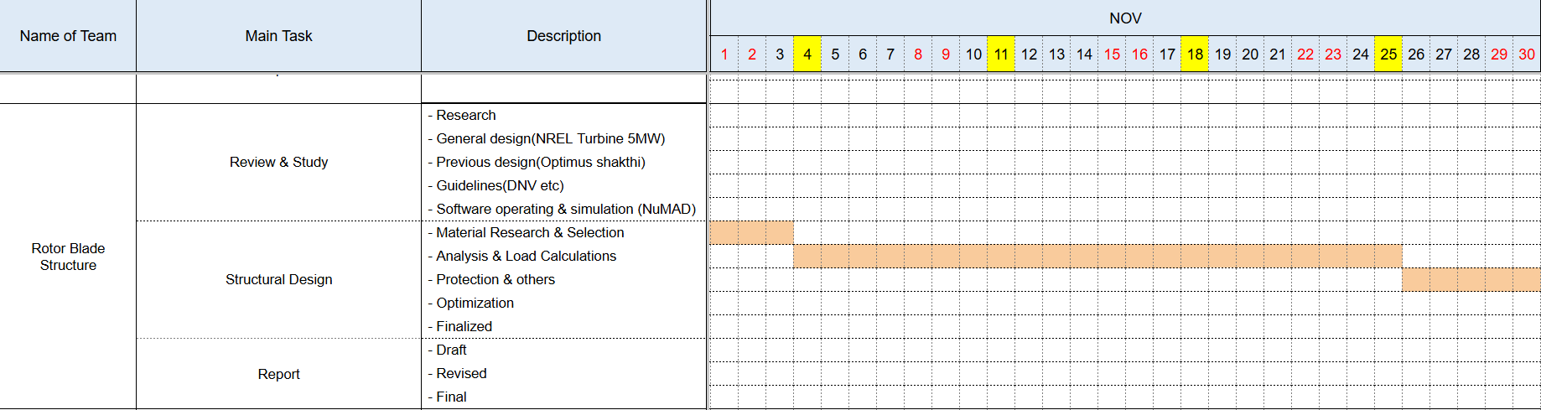
1. Rotor Blade Structures Team Time line -
1.1 Team Time line for Month November -
Anudeep Allanki

Slide 4
2. Tasks planned for Project –
Material Selection
Spar Cap & Shear Web Thickness
Develop Blade Model in NuMAD
Analysis with Precomp
Iterate and refine the design
Anudeep Allanki

Slide 5
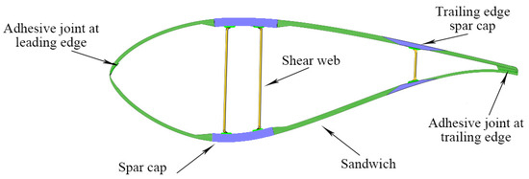
3. Spar Caps –
3.1 About Spar Caps -
The main structural component (backbone) of a wind turbine blade.
They are long, thick beams that run along the length of the blade.
Located on the top (suction side) and bottom (pressure side) of the blade's main spar, or internal "box beam.
Their primary job is to give the blade its stiffness and strength.
Figure 1 – Blade Structures
Source - Impact of Process Technology on Properties of Large-Scale Wind Turbine Blade Composite Spar Cap by Yuanrong Sun, Congli Hu, Jianbo Li
Anudeep Allanki

Slide 6
3. Spar Caps –
3.1.1 Types of Spar Caps –
a. Box Spar Design –
  It is the most common and conventional design.
  These two caps are connected by one or more vertical shear webs, forming a strong, hollow "box beam" that runs down the length of the blade.
  Key Features –
    Excellent at handling flapwise bending loads.
    The shear webs prevent the caps from moving relative to each other & maintain the blade's shape.
Anudeep Allanki

Slide 7
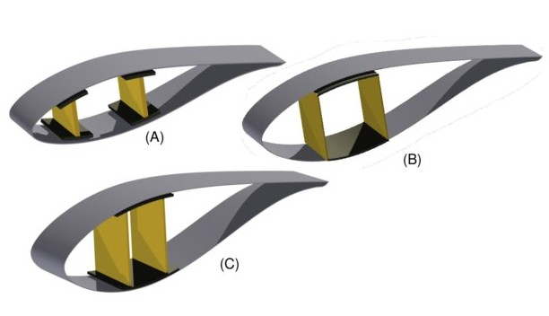
3. Spar Caps –
3.1.1 Types of Spar Caps –
a. Box Spar Design –
Figure 2 – Box Spar Caps,
A: three cell with shear webs & spar caps,
B: three cell box type, with single inter-web capping,
C: three cell, with single capping extending fore and aft of the shear webs.
Source - Multi-disciplinary constraint optimization of wind turbines by Carlo Luigi Bottasso, Filippo Campagnolo, Alessandro Croce
Anudeep Allanki

Slide 8
3. Spar Caps –
3.1.1 Types of Spar Caps –
b. Split Spar Cap Design –
  In this type, the main cap is divided into two or more separate sections.
  These "split" caps are still connected by shear webs, but this design offers specific structural advantages.
  Key Features –
    Increases Stability - improved the Blade's resistance to buckling.
    Better Stiffness - increased the Blade's stiffness in the "edgewise" direction
    Weight optimization - less weight of Blade without sacrificing strength.
Anudeep Allanki

Slide 9
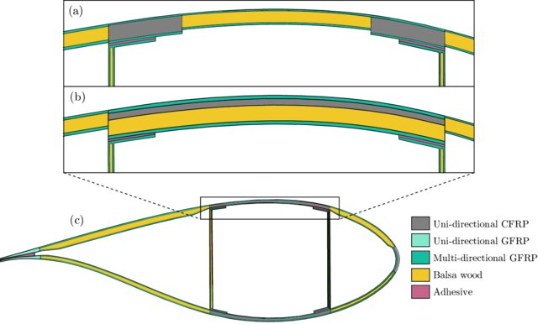
3. Spar Caps –
3.1.1 Types of Spar Caps –
b. Split Spar Cap Design –
Figure 3 – Topologies of
a: split spar cap (SSC) concept,
b:. continuous spar cap (CSC) concept,
c: baseline. ox Spar Caps.
Source - A concept study of a carbon spar cap design for a 80m wind turbine blade by Malo Rosemeier, M Bätge
Anudeep Allanki

Slide 10
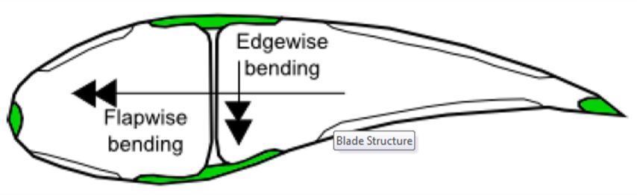
3. Spar Caps –
3.1.2 Types of Bending Moments on Spar Caps –
a. Primary Bending - Flapwise Bending
b. Secondary Bending: Edgewise Bending
Figure 4 – Bending Moments on Spar Caps
Source – Lecture Scripts from Prof. Dr. Francesco Previtali
Anudeep Allanki

Slide 11
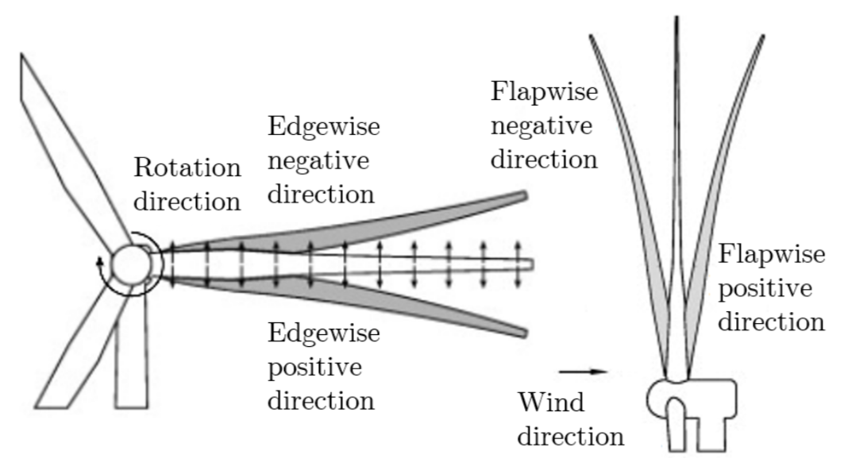
3. Spar Caps –
3.1.2 Types of Bending Moments on Spar Caps –
a. Primary Bending - Flapwise Bending
  This is the most significant load a spar cap is designed to handle.
  It's caused by the aerodynamic thrust of the wind pushing on the wide face of the blade.
  This force causes the blade to bend backwards and forwards.
Figure 5 – Flapwise Bending Moments on Blades
Source – Design & Analysis of Equipment for Load Introduction during Full Scale Blade Test by J. Andersen, M. Escudero, L. Larsen, J. Thuesen, A. Vissamsetty
Anudeep Allanki

Slide 12
3. Spar Caps –
3.1.2 Types of Bending Moments on Spar Caps –
b. Secondary Bending: Edgewise Bending
  This is the secondary bending load, acting parallel to the blade's direction of rotation. The main cause is gravity.
  It's called "edgewise" because the blade is bending along its thin leading and trailing edges.
  This load is a major driver of fatigue in the blade structure.
Figure 6 – Edgewise Bending Moments on Blades
Source – Design & Analysis of Equipment for Load Introduction during Full Scale Blade Test by J. Andersen, M. Escudero, L. Larsen, J. Thuesen, A. Vissamsetty
Anudeep Allanki

Slide 13

3. Spar Caps –
3.1.3 Bending Stiffness of Spar Caps –
a. Bending Stiffness (also called Flexural Rigidity) -
  It is the spar cap's fundamental resistance to bending.
  It's the most important property for preventing the blade from deflecting too much and striking the tower.
  It is NOT the same as strength (which is resistance to breaking).
  Stiffness is resistance to bending.
here,
  E = Young's Modulus (Material Stiffness),
  I = Second Moment of Area (Shape Stiffness)
$$Bending Stiffness = E×I$$
Anudeep Allanki

Slide 14
3. Spar Caps –
3.1.3 Bending Stresses on Spar Caps –
a. Bending Stress -
  Because a blade is always moving and bending, the stress on the spar caps is cyclical.
  This cycle is defined by a Maximum Stress (σ_{max}) & Minimum Stress (σ_{min}), which is the key driver of material fatigue and a critical part of the design.
Anudeep Allanki

Slide 15
3. Spar Caps –
3.1.3 Bending Stresses on Spar Caps –
a. Bending Stress -
  1. Maximum Stress (σ_{max}) –
    The highest tensile (pulling) stress experienced by the spar cap during its rotation.
    This occurs on the suction side (top) spar cap when the blade is hit by a strong gust of wind, causing it to bend backward (flapwise bending).
  2. Minimum Stress (σ_{min}) –
    The highest compressive (pushing) stress experienced by the spar cap.
    This occurs on the pressure side (bottom) spar cap during that same strong gust of wind.
Anudeep Allanki

Slide 16
3. Spar Caps –
3.1.4 Bending Stress Analysis on Spar Caps –
  a. Input Tables – (from WEC Shakthi 2024)
    loads.csv: spanwise position & flapwise bending moments
    thickness.csv: blade thickness (distance between spar caps)
  b. Material Properties –
    Glass Fiber: E = 43 GPa, σ_max = 750 MPa, ρ = 1930 kg/m³, SF = 1.6
Anudeep Allanki

Slide 17
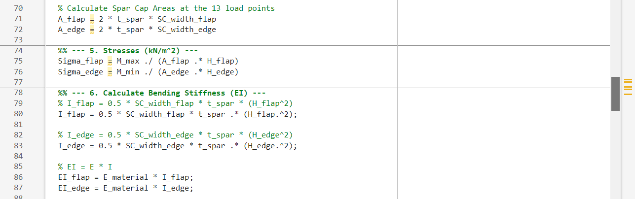
3. Spar Caps –
3.1.4 Bending Stress Analysis on Spar Caps –
  c. MatLab Code for Maximum Stress (σmax) & Minimum Stress (σmin)
  d. MatLab Code for Bending Stiffness (EI) for Flapwise & Edgewise Bending
Anudeep Allanki

Slide 18
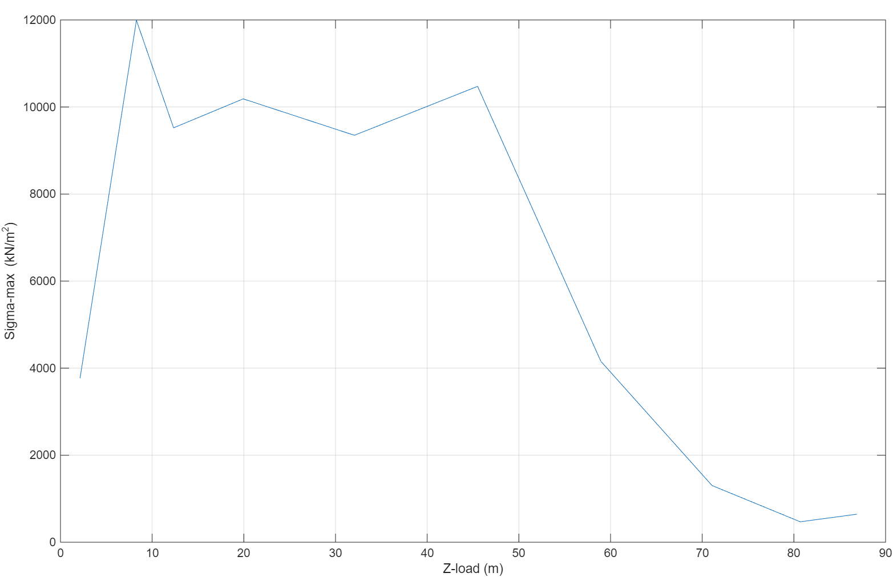
3. Spar Caps –
3.1.4 Bending Stress Analysis on Spar Caps –
  e. Plots from MatLab for Maximum Stress (σmax)
Anudeep Allanki

Slide 19
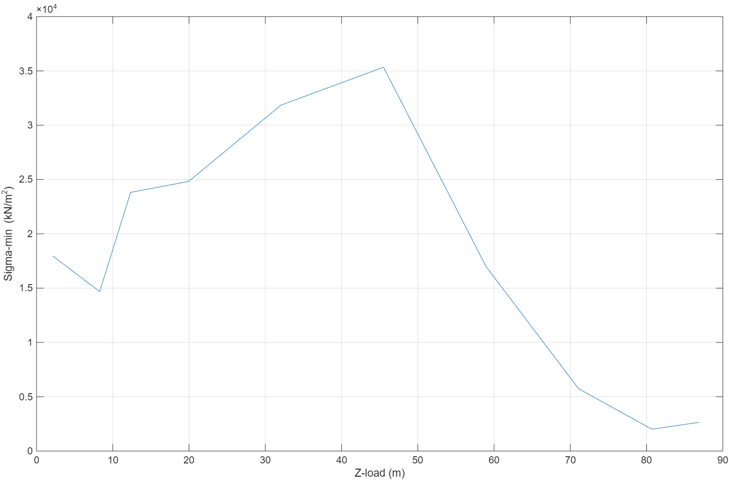
3. Spar Caps –
3.1.4 Bending Stress Analysis on Spar Caps –
  f. Plots from MatLab for Minimum Stress (σmin)
Anudeep Allanki

Slide 20
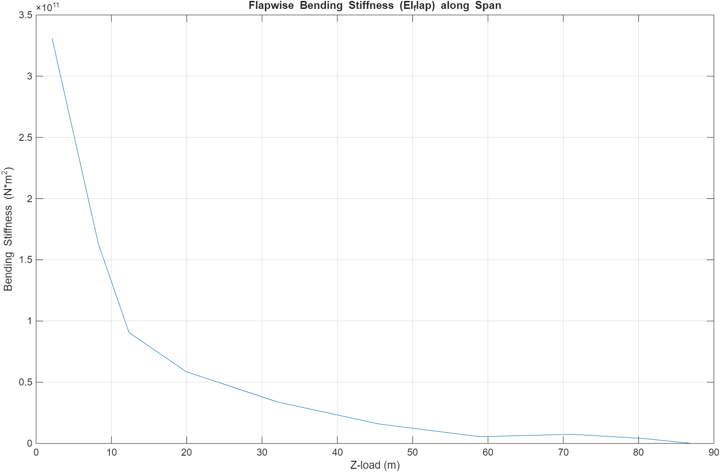
3. Spar Caps –
3.1.4 Bending Stress Analysis on Spar Caps –
  g. Plots from MatLab for Bending Stiffness (EI) for Flapwise Bending
Anudeep Allanki

Slide 21
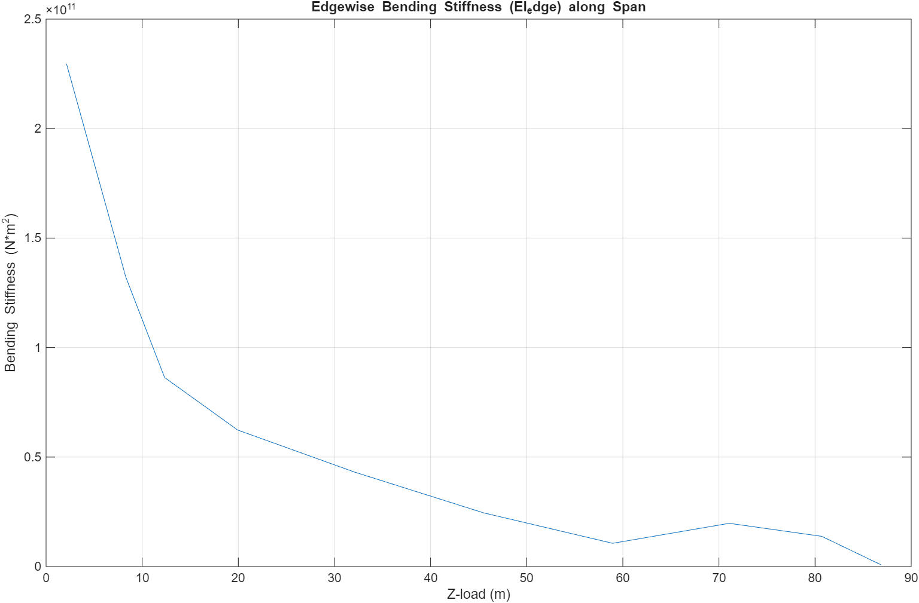
3. Spar Caps –
3.1.4 Bending Stress Analysis on Spar Caps –
  h. Plots from MatLab for Bending Stiffness (EI) for Edgewise Bending
Anudeep Allanki

Slide 22
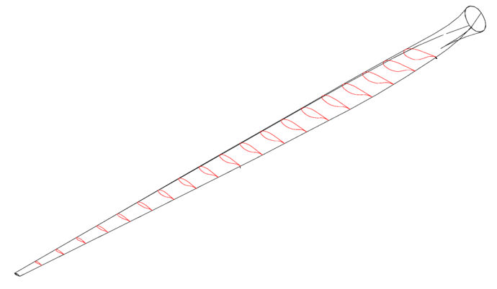
3. Spar Caps –
3.1.5 Data required to fix the Spar Caps & Webs Geometry –
  a. Blade Geometry -
  b. Load and Thickness Table (loads.csv & thickness.csv)
Loads Table
Span (m) | M_max (kN-m) | M_min (kN-m)
Thickness Table
Span (m) | Thickness (m)
Anudeep Allanki

Slide 23
Bibliography
Definition of a 5 MW/61.5m Wind Turbine Blade Reference Model by Brian R. Resor, Sandia National Laboratories, California, USA
Definition of a 5 MW Reference Wind Turbine for Offshore System Development, J. Jonkman, S. Butterfield, W. Musial, and G. Scott, National Renewable Energy Laboratory, USA
Reports from Optimus Shakthi 2024
Lecture Scripts from Prof. Dr. Francesco Previtali
Lecture Scripts from Prof. Dr. Laurence Alhrshy
Impact of Process Technology on Properties of Large-Scale Wind Turbine Blade Composite Spar Cap by Yuanrong Sun, Congli Hu, Jianbo Li
Multi-disciplinary constraint optimization of wind turbines by Carlo Luigi Bottasso, Filippo Campagnolo, Alessandro Croce
A concept study of a carbon spar cap design for a 80m wind turbine blade by Malo Rosemeier, M Bätge
Design & Analysis of Equipment for Load Introduction during Full Scale Blade Test by J. Andersen, M. Escudero, L. Larsen, J. Thuesen, A. Vissamsetty
Anudeep Allanki

